Slide 1
Exploring WebKit’s Just-in-Time Compilation
Off-By-One 2024
Vignesh S Rao
Notes:
Good afternoon everyone and welcome to this talk. The talk is titled WebKits JIT compilation however a lot of the initial slides will be applicable to other engines jit compilers too. We’ll talk about the motivation behind JIT compilation and see a couple of bugs that arise in jit compilers
Hopefully everyone can have some takeaways from this regardless of their experience levels with browsers

Slide 2

$whoami
Vignesh Rao (@sherl0ck_) - V.R. at Exodus Intelligence.
Notes:
So whoami ? My naoame is Vignesh Rao and I work as a vulnerability researcher for Exodus intelligence where most of my research has been around browsers

Slide 3
JavaScript
Untyped and interpreted language
let x = a + b
Bytecode
JS Virtual Machine
( Interpreter )
Notes:
So our focus is going to be on the JavaScript engine today. Now js is an untyped and interpreted lang. This means that when we have a statement like x = a + b, first its converted into something called bytecode and this bytecode is then executed by the interpreter. The bytecode is basically a lower level representation of the JS code some what similar to syntax as assembly code

Slide 4
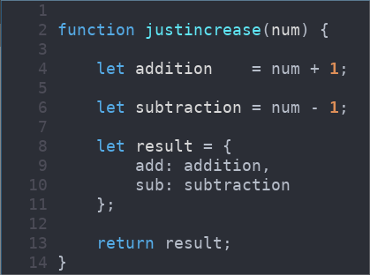
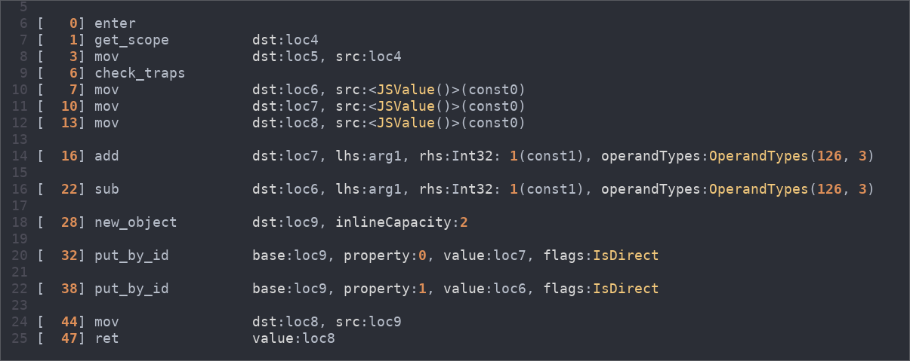
Side: JSC Bytecode
./jsc --dumpGeneratedBytecodes=true
The Bytecode emitted by JSC
The JS Function
Notes:
For those who are curious this is what JSC bytecode looks like. You can see each bytecode statement has a instruction and operand

Slide 5
Interpreter
Interpreter operates on the bytecode
Has a handler for each bytecode
Slow execution
Faster to start execution
void interpret(bytecode) {
switch (bytecode) {
case Add: ....
case Sub: ....
:
:
case CreateObject: ....
:
:
case StoreProperty: ....
case LoadProperty: ....
:
}
}
Notes:
The interpreter operates on the bc. Simple way to look at it is to imagine the interpreter as a big switch case where each case handles a specific instruction. Typically each instruction has a handler .

Slide 6
Interpreter
void interpret(bytecode) {
pc = Bytecode_Start;
loop {
switch (pc) {
case Add: ....
case Sub: ....
:
:
case CreateObject: ....
:
:
case StoreProperty: ....
:
case LoadProperty: ....
:
}
pc += 1;
}
}
Bytecode Array
Add a, b
Bytecode2
Fetch Bytecode
Bytecode3
Bytecode4
Resolve handler
Update PC
Notes:
The interpreter will fetch an instruction from the bc array into the prog counter, find out the handler for that bytecode and execute it and finally increment pc so that it points to the next bytecide op

Slide 7
Problems
Fetch - Resolve - Update Cycle is Expensive for repeated use
Need to provide for multiple types
let sum = a + b
a and b can be any type
Interpreter needs to handle all combinations

Slide 8
Problems
Fetch - Resolve - Update Cycle is Expensive for repeated use
Need to check for multiple types
No dependence between opcodes
let sum = a + b;
let sum2 = a + b;
let sum3 = a + b;
Add a, b
Add a, b
Store sum
Store sum
Add a, b
Store sum2
Store sum2
Store sum3
Add a, b
Store sum3

Slide 9
Solution: Compile Code
Convert JS Bytecode into Native Assembly
Only for code that runs multiple times

Slide 10
Baseline Compiler
Solves the Repeated Fetch-Resolve-Update cycle
JavaScript
Bytecode
Baseline Compiled
let sum = a + b;
let prod = a * b;
let obj = {};
Add a, b
mov rdi, a
mov rsi, b
call Handle_Sum
Store sum
Mul a, b
mov [sum], rax
Store prod
mov rdi, a
mov rsi, b
call Handle_Mul
mov [prod], rax
call Handle_CreateObj
mov [obj], rax
CreateObj
Store obj

Slide 11
Baseline JIT
Template JIT → emits specific assembly for specific bytecodes
Very few optimizations are performed
Generates code very fast
Resultant code may not be the most efficient.

Slide 12
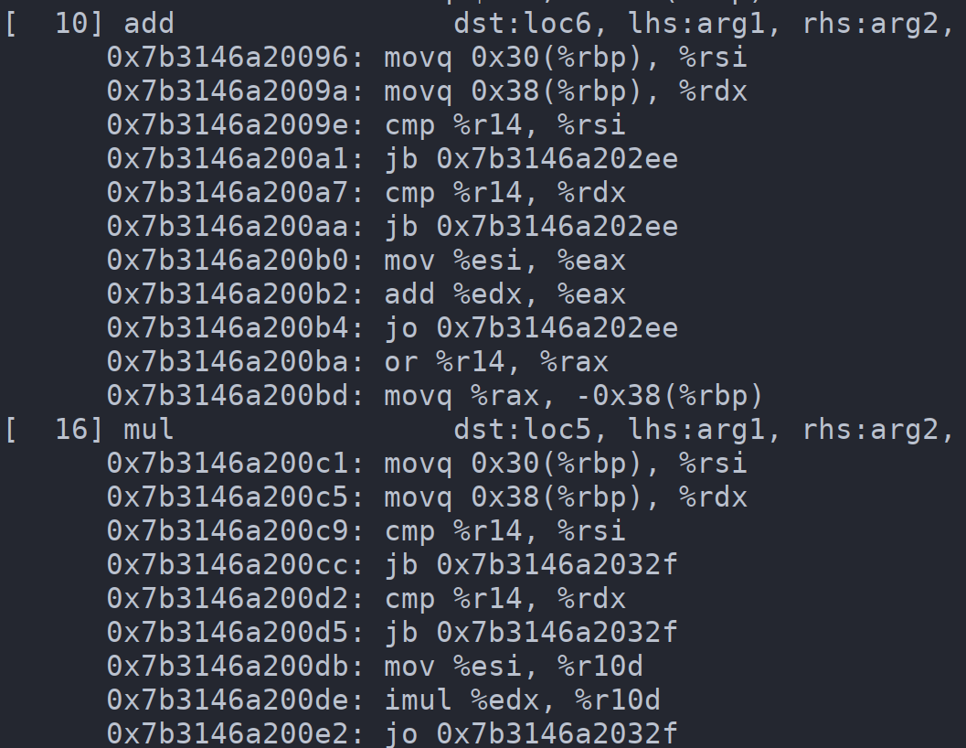
JSC Baseline JIT
./jsc --dumpDisassembly=true

Slide 13
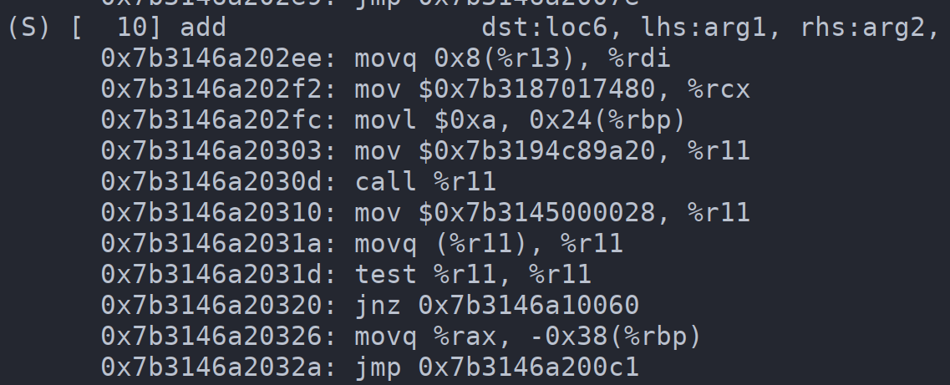
JSC Baseline JIT

Slide 14
Object Structure in JavaScript
let x = {};
x.prop1 = 0x1234;
x.prop2 = 0x1337;
x[0] = 1;
x[1] = 2;
prop1: 0 prop2: 1
shape
properties
0x1234
elements
0x1337
1
2

Slide 15
Property Access
let x = {};
x.prop1 = 0x1234;
x.prop2 = 0x1337;
x[0] = 1;
x[1] = 2;
…
…
function access(a) {
return a.prop2;
}
prop1: 0 prop2: 1
shape
properties
0x1234
elements
0x1337
1
2

Slide 16
Inline Caching
let x = {};
x.prop1 = 0x1234;
x.prop2 = 0x1337;
x[0] = 1;
x[1] = 2;
…
…
function access(a) {
return a.prop2;
}
prop1: 0 prop2: 1
shape
S1
properties
0x1234
elements
DEFAULT
0x1337
DEFAULT
DEFAULT
1
2

Slide 17
Inline Caching
let x = {};
x.prop1 = 0x1234;
x.prop2 = 0x1337;
x[0] = 1;
x[1] = 2;
…
…
function access(a) {
return a.prop2;
}
prop1: 0 prop2: 1
shape
S1
properties
0x1234
elements
S1, 1
0x1337
DEFAULT
DEFAULT
1
2

Slide 18
Inline Caching
let x = {};
x.prop1 = 0x1234;
x.prop2 = 0x1337;
x[0] = 1;
x[1] = 2;
…
…
function access(a) {
return a.prop2;
}
prop1: 0 p: 1 prop2: 2
shape
S2
properties
0x1234
elements
S1, 1
0x1337
DEFAULT
DEFAULT
1
2

Slide 19
Inline Caching
let x = {};
x.prop1 = 0x1234;
x.prop2 = 0x1337;
x[0] = 1;
x[1] = 2;
…
…
function access(a) {
return a.prop2;
}
prop1: 0 p: 1 prop2: 2
shape
properties
0x1234
elements
S1, 1
0x1337
S2, 2
DEFAULT
1
2

Slide 20
Problems With Interpreter
Fetch - Resolve - Update Cycle is Expensive for repeated use
Need to check for multiple types
No dependence between opcodes

Slide 21
Optimizing Compilers
Slower to generate code
Resultant code runs faster
More optimizations → Slower Compilation → Efficient Code
To offset this tradeoff - Use multiple Compilers
Each does more optimizations than the previous one
Speculate Types → Deoptimize if Speculation fails
Notes:
Slow to gen code, one of the reasons is that bytecode does not store opcode dependency info so there is a need for a new rep. This is called IR and the compiler first has to convert bc to IR

Slide 22
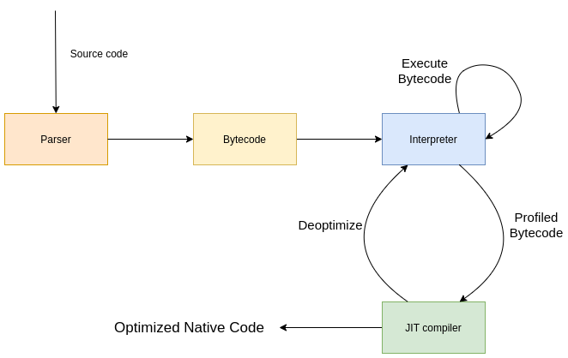
JavaScript Compilation
Notes:
Javi
When a user visits a web, at some point some JavaScript code might be downloaded. This means that all the machinery in Safari is getting ready to start running JS code. The first thing that comes into play is the parser. Given that the script has no syntax errors, it will turn the javascript script into bytecode. A variable assignment will have a certain bytecode assigned to it or an addition of two integers will have a different bytecode. Even an addition of an integer and a double. Even an addition of a double with an object will have a different bytecode representation. This bytecode is then fed into the interpreter which has knowledge of how to run the bytecode in the target architecture. However, because each bytecode is different, it also comes with profiling. This is, among other pieces of data, the types of the values that are being used and so, we enter the JIT Compiler. Better and faster code will be compiled at runtime in the background while all the JS engine is executing. If one of those assumptions broke, then the code is thrown away and jumps back to the interpreter to re-profile the bytecode if possible.
NOTE: Guide through an example of 1+1 and 1+Object to show Interpreter vs JIT Compiler.
When a user visits a webpage the source js code is “downloaded” by the browser and then passed over to the js engine. All the browser engines start by converting the source into a format that is more readable and workable by the engine. This process is called parsing. The engine parses the source code into a representation called bytecode. Thus the parser consumes the raw source and converts it into bytecode which it outputs. Next the bytecode is consumed by the interpreter and at this point the js code “executing”. However the interpreter is slow as it has to handle all the cases that might arise in the JS source. For example the “add” operation in js can be an addition of integers, floats , objects or any permutation of these. Thus the interpreter needs to be aware about how to handle this in each case and this leads to it becoming very slow as it has to do a lot of checks to see the types of the operands that are being passed in order to determine which path is to be taken. Modern webpages use huge amount of JS and in many cases large part of the js code runs in a loop. Thus each engine comes with a jit compiler which can compile the JS (or parts of it) into native code and apply many optimizations which will enable it to run faster. For compilation however, its necessary that type information be present so its the job of the interpreter to profile the bytecode and observe which all types are seen at a call site. With this information, the JIT compiler can apply heavy optimizations to the bytecode and eventually convert it into machine code . However it is possible that during runtime, some assumptions made by the compiler might be broken because of different types of objects or a change in the environment. In such a case the engine will throw out the jit compiled code and resume execution in the slow interpreter which handles all the cases.

Slide 23
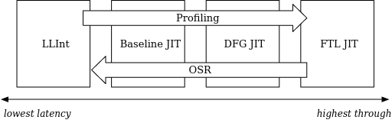
Introduction to JavaScriptCore - Execution tiers
LLINT: Initial interpreter, not a compiler, written in custom assembly
Baseline compiler: Minimal optimizations, less time spent on compiling
DFG: More optimizations, more time spent on compiling
FTL: All standard compiler optimizations, max time spent in compiling
Image credit - https://webkit.org/blog/10308/speculation-in-javascriptcore/
Notes:
JavaScriptCore has many execution Tiers. We can see in the image how we go from the interpreter to JIT pipeline. LLINT and the Baseline compiler are execution tiers that generate code faster but run it slower. Whereas DFG and JIT do compile code based on certain code usage assumptions to run faster code but take a bit longer to generate.

Slide 24
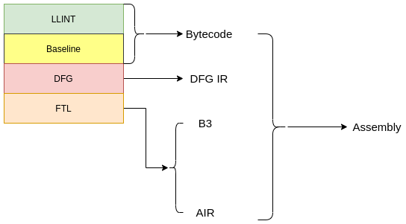
Introduction to JavaScriptCore - IR’s
Notes:
Bytecode is not suitable for optimizing compilers. Hence we need another form to represent the code in a compiler friendly manner. This form is called a Compiler IR and different compilers use Different IRs.
Very quickly and for completion, in this slide we can see which execution tiers use which Intermediate Representations: LLINT and Baseline rely on bytecode, DFG has its own DFG IR and FTL uses B3 (barebones backend and Assembly IR)
FTL

Slide 25
Types in DFG
SpeculatedType | Abstract Value
Signifies the most possible value of a node | All possible types of a node
Types Needs to be checked at runtime | Does not need to be verified
Computed using profiling data and propagation | Computed using the Abstract Interpreter (DFG AI)
Used to construct the IR | Used to optimize the IR

Slide 26
AbstractValue
struct AbstractValue {
...
StructureAbstractValue m_structure;
SpeculatedType m_type;
ArrayModes m_arrayModes;
AbstractValueClobberEpoch m_effectEpoch;
JSValue m_value;
}
List of all possible structures
All types of this node
All possible indexing modes
Actual JSValue if this node is const
const obj = {p1: 1234}
AV(obj).m_value = address_of(obj);
m_value gives no info about structures
obj.p2 = 0x1234 → Structures changes

Slide 27
AbstractValue
struct AbstractValue {
...
StructureAbstractValue m_structure;
SpeculatedType m_type;
ArrayModes m_arrayModes;
AbstractValueClobberEpoch m_effectEpoch;
JSValue m_value;
}
List of all possible structures
All types of this node
Actual JSValue if this node is const
TOP: Anything
BOTTOM: Nothing (NULL set)

Slide 28
DFG Abstract Interpreter
Called DFG AI
Main purpose is to find out the concrete type of a node
DFGAbstractInterpreterInlines.h
Notes:
AI can be thought of as a type of interpreter. It does not execute the code per se, but it sort of does a partial execution to give information about a specific aspect of the code. For eg, in our now familiar case of let sum = a + b, if a and b are numbers then sum is also going to be a number. The process of finding this out is called AI

Slide 29
Property Access in DFG
First fetch the structure and check against a defined one
If check fails then bail out
If check passes fetch the property
Do a direct access with offset to fetch
DFG
CheckStructure( object, S1 )
GetByOffset( object→properties , 0 )
let x = object.p1
IC
S1, 0

Slide 30
CheckStructure
DFG IR Node to perform Shape Checks
Accepts 2 operands -
The base object
The structure to check
CheckStructure( obj, S1) →
Fetches the structure of obj
Compares it with S1
If the compare fails, code bails out of JIT

Slide 31
Property Access
// Structure of x1 = S1 --> p1 at offset 0
let x1 = {p1: 0x1337}
// Structure of x2 = S2 --> p1 at offset 0
let x2 = {p1: 0x1337, p2: 0x1234}
// Structure of x3 = S3 --> p1 at offset 1
let x3 = {p2: 0x1234, p1: 0x1337}
function access(arg) {
return arg.p1;
}
S1, p1 → 0
S2, p1 → 0
S3, p1 → 1

Slide 32
GetByStatus
class GetByStatus final {
...
Vector<GetByVariant, 1> m_variants;
Box<ModuleNamespaceData> m_moduleNamespaceData;
State m_state;
bool m_wasSeenInJIT { false };
};
Tracks Property Access at a point

Slide 33
GetByVariant
class GetByVariant {
...
StructureSet m_structureSet;
ObjectPropertyConditionSet m_conditionSet;
PropertyOffset m_offset;
std::unique_ptr<CallLinkStatus> m_callLinkStatus;
JSFunction* m_intrinsicFunction;
CodePtr<CustomAccessorPtrTag> m_customAccessorGetter;
std::unique_ptr<DOMAttributeAnnotation> m_domAttribute;
CacheableIdentifier m_identifier;
};
Keeps track of all Structures with property offset `m_offset`

Slide 34
GetByVariant
class GetByVariant {
...
StructureSet m_structureSet;
ObjectPropertyConditionSet m_conditionSet;
PropertyOffset m_offset;
std::unique_ptr<CallLinkStatus> m_callLinkStatus;
JSFunction* m_intrinsicFunction;
CodePtr<CustomAccessorPtrTag> m_customAccessorGetter;
std::unique_ptr<DOMAttributeAnnotation> m_domAttribute;
CacheableIdentifier m_identifier;
};
// Structure of x1 = S1 --> p1 at offset 0
let x1 = {p1: 0x1337}
// Structure of x2 = S2 --> p1 at offset 0
let x2 = {p1: 0x1337, p2: 0x1234}
// Structure of x3 = S3 --> p1 at offset 1
let x3 = {p2: 0x1234, p1: 0x1337}
function access(arg) {
return arg.p1;
}
V1 → [S1, S2], 0
V2 → [S3], 1

Slide 35
GetByStatus: Recap
GetByStatus → Tracks property access as array of Variants
Variant → Tracks the offset and a set of structures
Creation
Inline Cache Information
Structures

Slide 36
Abstract Interpretation for GetById
case GetById: {
AbstractValue& value = forNode(node->child1());
...
UniquedStringImpl* uid = node->cacheableIdentifier().uid();
GetByStatus status = GetByStatus::computeFor(value.m_structure.toStructureSet(), uid);
...
AbstractValue result;
for (unsigned i = status.numVariants(); i--;) {
...
const auto& variant = status[i];
result.merge(
m_graph.inferredValueForProperty(
value, status[i].offset(), m_state.structureClobberState()));
object.p1 → GetByID( object, p1 )
m_value.properties[offset]
Predicts value of GetById

Slide 37
The Bug
case GetById: {
AbstractValue& value = forNode(node->child1());
...
UniquedStringImpl* uid = node->cacheableIdentifier().uid();
GetByStatus status = GetByStatus::computeFor(value.m_structure.toStructureSet(), uid);
...
AbstractValue result;
for (unsigned i = status.numVariants(); i--;) {
...
const auto& variant = status[i];
result.merge(
m_graph.inferredValueForProperty(
value, status[i].offset(), m_state.structureClobberState()));
Same JSObject used with different offsets
Predicts value of GetById

Slide 38
Vulnerability
AbstractValue(access_obj)
Structures:
S1 → p1: 0
S2 → p1: 1
Value:
obj1
// Structure S
let constobj = {value: 0x1337}
// Structure S1 --> p1: 0 and p2: 1
let obj1 = {}
obj1.p1 = constobj;
obj1.p2 = constobj;
...
access_object.p1
AbstractValue result;
for (unsigned i = status.numVariants(); i--;) {
...
const auto& variant = status[i];
result.merge(
m_graph.inferredValueForProperty(
value, status[i].offset(), m_state.structureClobberState()));
GetProperty(obj1, 0)

Slide 39
Vulnerability
AbstractValue(access_obj)
Structures:
S1 → p1: 0
S2 → p1: 1
Value:
obj1
// Structure S
let constobj = {value: 0x1337}
// Structure S1 --> p1: 0 and p2: 1
let obj1 = {}
obj1.p1 = constobj;
obj1.p2 = constobj;
...
access_object.p1
AbstractValue result;
for (unsigned i = status.numVariants(); i--;) {
...
const auto& variant = status[i];
result.merge(
m_graph.inferredValueForProperty(
value, status[i].offset(), m_state.structureClobberState()));
GetProperty(obj1, 1)

Slide 40
Vulnerability
AbstractValue(access_obj)
Structures:
S1 → p1: 0
S2 → p1: 1
Value:
obj1
// Structure S
let constobj = {value: 0x1337}
// Structure S1 --> p1: 0 and p2: 1
let obj1 = {}
obj1.p1 = constobj;
obj1.p2 = constobj;
...
access_object.p1
AbstractValue result;
for (unsigned i = status.numVariants(); i--;) {
...
const auto& variant = status[i];
result.merge(
m_graph.inferredValueForProperty(
value, status[i].offset(), m_state.structureClobberState()));
AbstractValue(result) = constobj

Slide 41
Incorrect AbstractValue
Vulnerability sets an incorrect abstract value for a node
AbstractValue is trusted by the compiler
Used to optimize more code

Slide 42
Constant Folding
Used by DFG IR to apply AbstractValue information
ToNumber(obj) → Used to convert obj to a number
AbstractValue(obj) → Number
ToNumber(obj) → obj i.e ToNumber got optimized out

Slide 43
Constant Folding
case CheckStructure: {
AbstractValue& value = m_state.forNode(node->child1());
set = node->structureSet();
if (value.m_structure.isSubsetOf(set)) {
…
node->remove(m_graph);
eliminated = true;
break;
}
CheckStructure( object, S1 )
GetByOffset( object→properties , 0 )
let x = object.p1

Slide 44
Constant Folding
case CheckStructure: {
AbstractValue& value = m_state.forNode(node->child1());
set = node->structureSet();
if (value.m_structure.isSubsetOf(set)) {
…
node->remove(m_graph);
eliminated = true;
break;
}
Set is Subet of sets reported by AV
The CheckStructure will always pass
CheckStructure( object, S1 )
GetByOffset( object→properties , 0 )
let x = object.p1

Slide 45
Exploitation
// Structure S
let constobj = {value: 0x1337}
// Structure S1 --> p1: 0 and p2: 1
let obj1 = {}
obj1.p1 = constobj;
obj2.p2 = constobj;
...
let access = access_object.p1
access.value
AbstractValue(access)
= constobj (S)

Slide 46
Exploitation
// Structure S
let constobj = {value: 0x1337}
// Structure S1 --> p1: 0 and p2: 1
let obj1 = {}
obj1.p1 = constobj;
obj2.p2 = constobj;
...
let access = access_object.p1
access.value
AbstractValue(access)
= constobj (S)
CheckStructure( access, S)
GetByOffset(access→properties, 0)

Slide 47
Exploitation
// Structure S
let constobj = {value: 0x1337}
// Structure S1 --> p1: 0 and p2: 1
let obj1 = {}
obj1.p1 = constobj;
obj2.p2 = constobj;
...
let access = access_object.p1
access.value
AbstractValue(access) = S
Reference Struct = S
Const Fold
CheckStructure( access, S)
GetByOffset(access→properties, 0)

Slide 48
Exploitation
// Structure S
let constobj = {value: 0x1337}
// Structure S1 --> p1: 0 and p2: 1
let obj1 = {}
obj1.p1 = constobj;
obj2.p2 = constobj;
...
let access = access_object.p1
access.value
Eliminate CheckStructure
Const Fold
CheckStructure( access, S)
GetByOffset(access→properties, 0)

Slide 49
Exploitation
// Structure S
let constobj = {value: 0x1337}
// Structure S1 --> p1: 0 and p2: 1
let obj1 = {}
obj1.p1 = constobj;
obj2.p2 = constobj;
...
let access = access_object.p1
access.value
Direct Access Without Checks
GetByOffset(access→properties, 0)

Slide 50
Exploitation
// Structure S
let constobj = {value: 0x1337}
// Structure S1 --> p1: 0 and p2: 1
let obj1 = {}
obj1.p1 = constobj;
obj2.p2 = constobj;
...
let access = access_object.p1
access.value
AV(access_object) = S1, S2

Slide 51
Exploitation
// Structure S
let constobj = {value: 0x1337}
// Structure S1 --> p1: 0 and p2: 1
let obj1 = {}
obj1.p1 = constobj;
obj2.p2 = constobj;
...
let access = access_object.p1
access.value
Compiler Only checked S1

Slide 52
Exploitation
// Structure S
let constobj = {value: 0x1337}
// Structure S1 --> p1: 0 and p2: 1
let obj1 = {}
obj1.p1 = constobj;
obj2.p2 = constobj;
...
let access = access_object.p1
access.value
With S2, p1 can be anything

Slide 53
Exploitation
// Structure S
let constobj = {value: 0x1337}
// Structure S1 --> p1: 0 and p2: 1
let obj1 = {}
obj1.p1 = constobj;
obj2.p2 = constobj;
...
let access = access_object.p1
access.value
The code will do a direct access on it

Slide 54
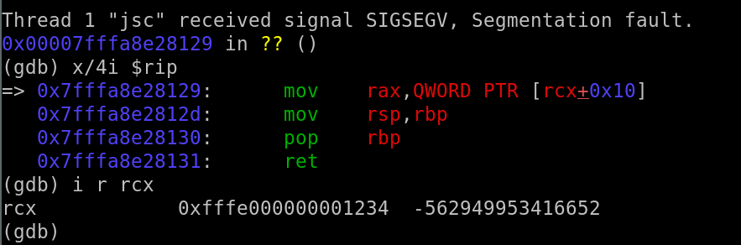
Exploitation

Slide 55
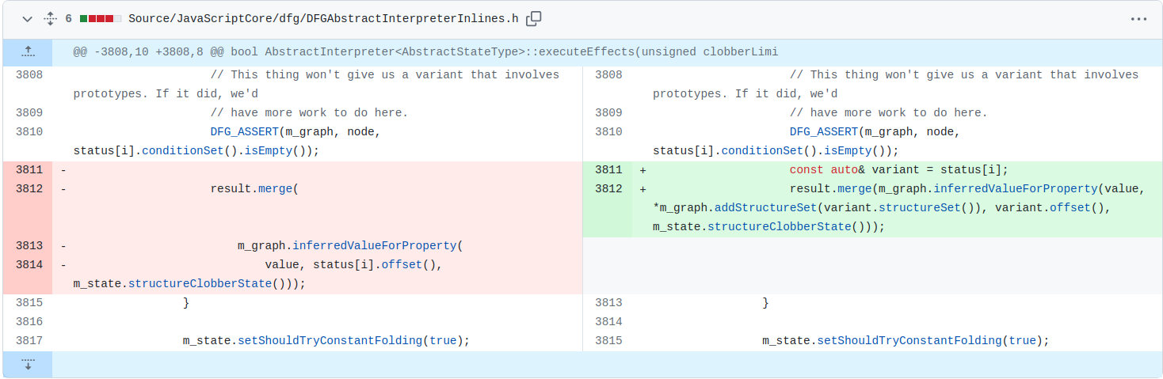
Patch
https://github.com/WebKit/WebKit/commit/690ddf9c00c2d19da81d1833b1e29db2780955b6

Slide 56
JSValue
Already saw the object structure
JS has to represent all sorts of values
Interpreter has to encode type information
let obj = {p1: 1}
0x00007fffa44b0180
Upper 15 bits NULL
let num = 0x1234;
0xfffe000000001234
Upper 15 bits set
let flot = 1.1;
0x3ff399999999999a
Add 2**49 to IEEE float rep
JSC only uses one NaN value → pureNaN
0x7ff8000000000000 → Double Value
0x7ffa000000000000 → Tagged Value (after adding 2**49)

Slide 57
Bug 2 - NaN Bug
File: Source/JavaScriptCore/dfg/DFGSpeculativeJIT64.cpp
void SpeculativeJIT::compileGetByValOnFloatTypedArray(Node* node, TypedArrayType type, const ScopedLambda<std::tuple<JSValueRegs, DataFormat, CanUseFlush>(DataFormat preferredFormat)>& prefix)
{
// [TRUNCATED]
switch (elementSize(type)) {
// [TRUNCATED]
case 8: {
m_jit.loadDouble(MacroAssembler::BaseIndex(storageReg, propertyReg, MacroAssembler::TimesEight), resultReg);
break;
}
if (format == DataFormatJS) {
m_jit.boxDouble(resultReg, resultRegs);
jsValueResult(resultRegs, node);
} else {
// [TRUNCATED]
Notes:
When we were looking at the previous bug we came across this function. compileGetByValonFloatTypedArray

Slide 58
Bug 2 - NaN Bug
File: Source/JavaScriptCore/dfg/DFGSpeculativeJIT64.cpp
void SpeculativeJIT::compileGetByValOnFloatTypedArray(Node* node, TypedArrayType type, const ScopedLambda<std::tuple<JSValueRegs, DataFormat, CanUseFlush>(DataFormat preferredFormat)>& prefix)
{
// [TRUNCATED]
switch (elementSize(type)) {
// [TRUNCATED]
case 8: {
m_jit.loadDouble(MacroAssembler::BaseIndex(storageReg, propertyReg, MacroAssembler::TimesEight), resultReg);
break;
}
if (format == DataFormatJS) {
m_jit.boxDouble(resultReg, resultRegs);
jsValueResult(resultRegs, node);
} else {
// [TRUNCATED]

Slide 59
Bug 2 - NaN Bug
let array = new Float64Array(10);
let val = array[ 0 ] ;
GetByVal

Slide 60
Bug 2 - NaN Bug
let array = new Float64Array(10);
let val = array[ 0 ] ;
GetByVal
GetByVal on a Float Typed Array

Slide 61
Bug 2 - NaN Bug
File: Source/JavaScriptCore/dfg/DFGSpeculativeJIT64.cpp
void SpeculativeJIT::compileGetByValOnFloatTypedArray(Node* node, TypedArrayType type, const ScopedLambda<std::tuple<JSValueRegs, DataFormat, CanUseFlush>(DataFormat preferredFormat)>& prefix)
{
// [TRUNCATED]
switch (elementSize(type)) {
// [TRUNCATED]
case 8: {
m_jit.loadDouble(MacroAssembler::BaseIndex(storageReg, propertyReg, MacroAssembler::TimesEight), resultReg);
break;
}
if (format == DataFormatJS) {
m_jit.boxDouble(resultReg, resultRegs);
jsValueResult(resultRegs, node);
} else {
// [TRUNCATED]

Slide 62
Bug 2 - NaN Bug
File: Source/JavaScriptCore/dfg/DFGSpeculativeJIT64.cpp
resultReg = storage[index * 8]
void SpeculativeJIT::compileGetByValOnFloatTypedArray(Node* node, TypedArrayType type, const ScopedLambda<std::tuple<JSValueRegs, DataFormat, CanUseFlush>(DataFormat preferredFormat)>& prefix)
{
// [TRUNCATED]
switch (elementSize(type)) {
// [TRUNCATED]
case 8: {
m_jit.loadDouble(MacroAssembler::BaseIndex(storageReg, propertyReg, MacroAssembler::TimesEight), resultReg);
break;
}
if (format == DataFormatJS) {
m_jit.boxDouble(resultReg, resultRegs);
jsValueResult(resultRegs, node);
} else {
// [TRUNCATED]

Slide 63
Bug 2 - NaN Bug
File: Source/JavaScriptCore/dfg/DFGSpeculativeJIT64.cpp
void SpeculativeJIT::compileGetByValOnFloatTypedArray(Node* node, TypedArrayType type, const ScopedLambda<std::tuple<JSValueRegs, DataFormat, CanUseFlush>(DataFormat preferredFormat)>& prefix)
{
// [TRUNCATED]
switch (elementSize(type)) {
// [TRUNCATED]
case 8: {
m_jit.loadDouble(MacroAssembler::BaseIndex(storageReg, propertyReg, MacroAssembler::TimesEight), resultReg);
break;
}
if (format == DataFormatJS) {
m_jit.boxDouble(resultReg, resultRegs);
jsValueResult(resultRegs, node);
} else {
// [TRUNCATED]
Tag the raw float to make it a JSValue

Slide 64
Bug 2 - NaN Bug
File: Source/JavaScriptCore/jit/AssemblyHelpers.h
void boxDouble(FPRReg fpr, JSValueRegs regs, TagRegistersMode mode = HaveTagRegisters)
{
boxDouble(fpr, regs.gpr(), mode);
}
GPRReg boxDouble(FPRReg fpr, GPRReg gpr, TagRegistersMode mode = HaveTagRegisters)
{
moveDoubleTo64(fpr, gpr);
if (mode == DoNotHaveTagRegisters)
sub64(TrustedImm64(JSValue::NumberTag), gpr);
// [TRUNCATED]
return gpr;
}
NumberTag = 0xfffe000000000000
Notes:
The code basically subtracts negative 2**50 which is same as adding 2**50. However this operation is without any checkes whatsoever and the resutl of the GetByVal is fully controlled by us

Slide 65

Bug 2 - NaN Bug
sub64(TrustedImm64(JSValue::NumberTag), gpr);
Impure NaN == 0xFFFE000012345678
-
NumberTag == 0xFFFE000000000000
(JSValue*)0x0000000012345678
https://www.youtube.com/watch?v=k1wEJFqirT8
Notes:
Thus if a value like that on the left is provided as the input, the number tag will be subtracted and the fffe will cancel out leaving all the top bits unset. As we saw before, all top bits unset means that this JSValue is a pointer. Hence we are now able to create pointers out of thin air!

Slide 66
Learnings
Compare implementations across compilers
Hunt for assumptions and verify they are checked or invariant
Look for Variants

Slide 67
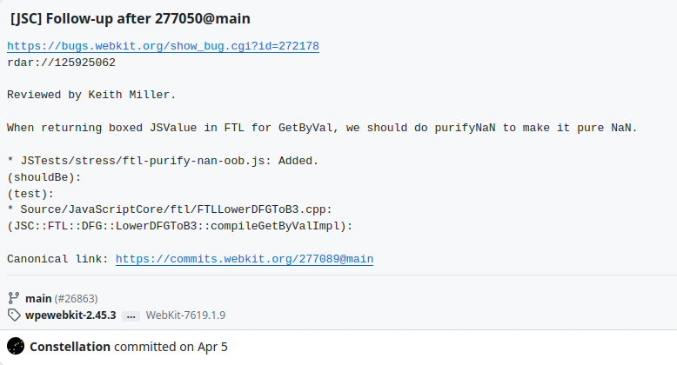
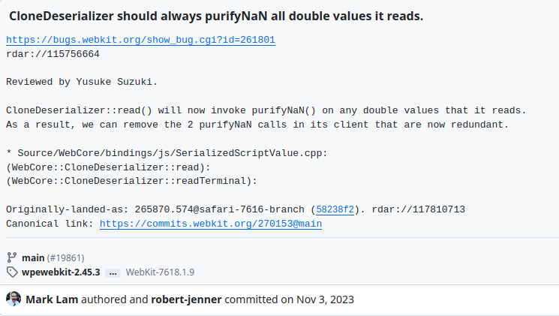
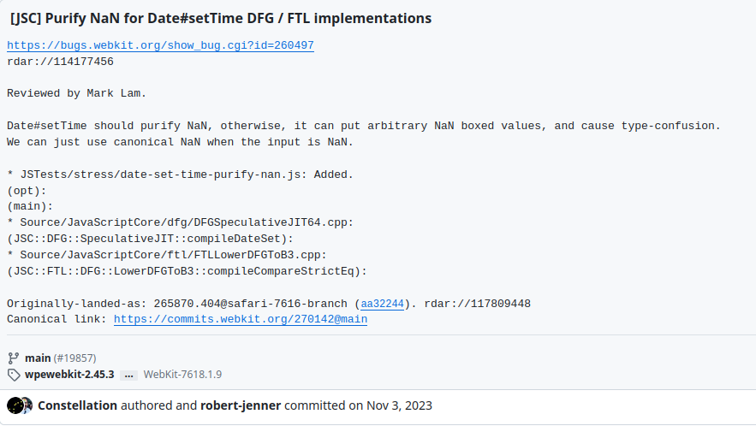
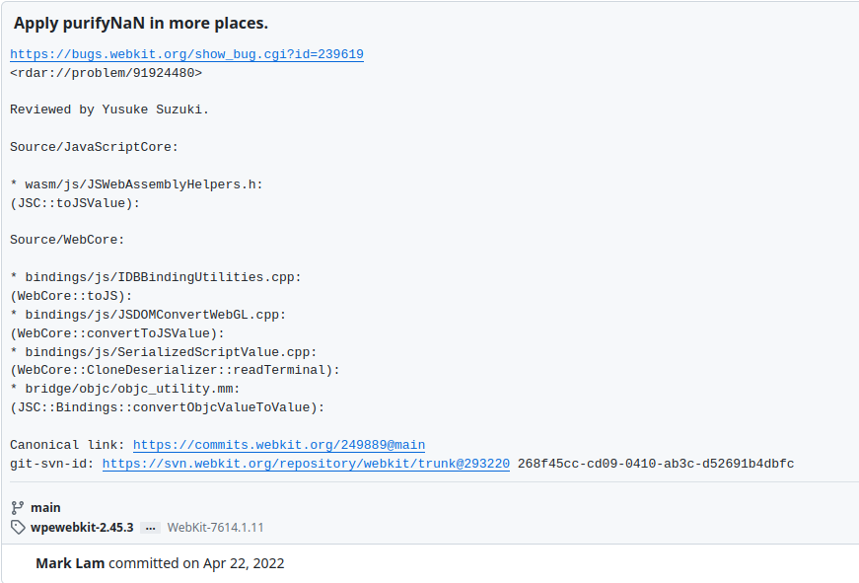
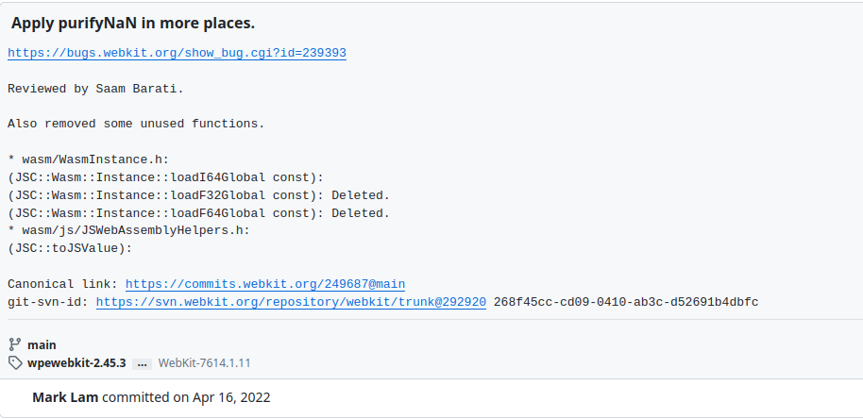
Learnings
Compare implementations across compilers
Hunt for assumptions and verify they are checked or invariant
Look for Variants

Slide 68
Learnings
Compare implementations across compilers
Hunt for assumptions and verify they are checked or invariant
Look for Variants
New Code -
More likely area for bugs
However more eyes, active fuzzing
Explore the depth

Slide 69
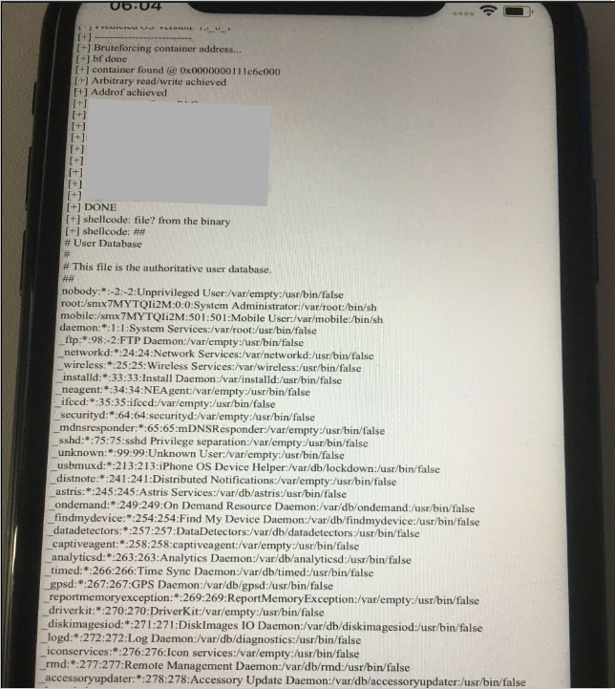
Full exploit on iOS
Full Exploit on Safari on iOS
Exploit runs shellcode
Displays contents of /etc/passwd

Slide 70

FIN

